Slide 1
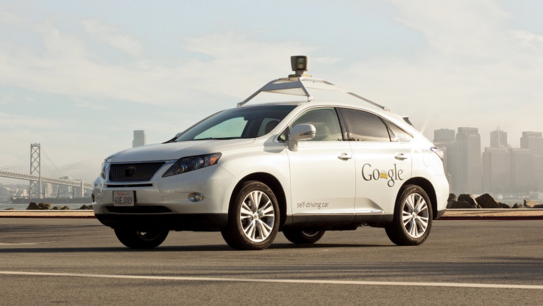
Connected Cars & Autonomous Vehicles
The current state of Cybersecurity

Slide 2

A presentation given to the
Self Driving and Autonomous
Vehicle Technology meetup
group at the Brighton Digital
Catapult on January 20th 2017
Provides high-level overview of issues around cybersecurity of Connected Cars and what automotive industry is doing to address the problem

Slide 3
About your presenter

Slide 5
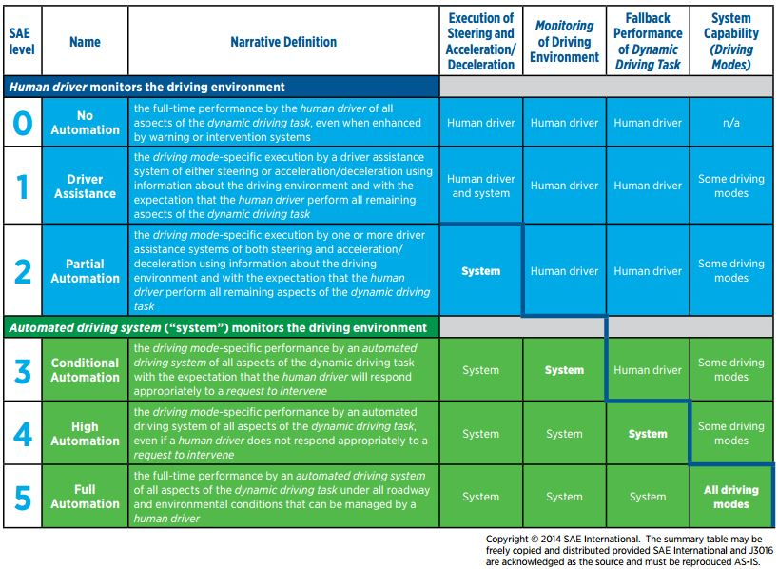
The story so far …
Society of Automotive Engineers: standard SAE J3016 defines classes of
vehicle automation

Slide 6
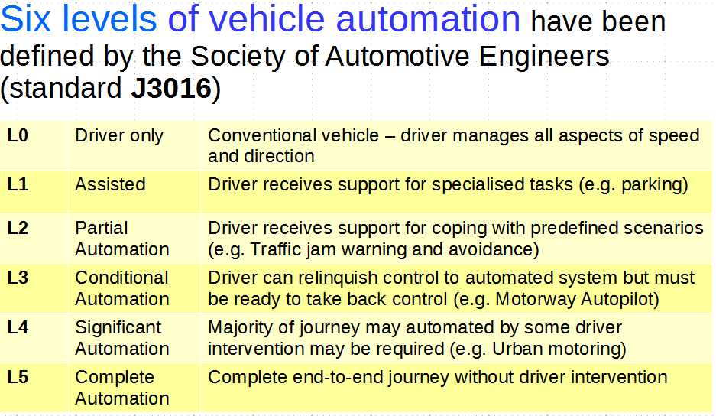
Levels of Vehicle Automation

Slide 7
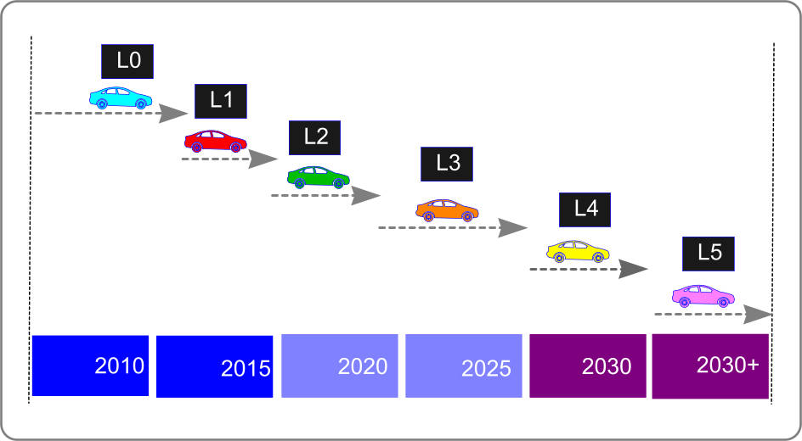
Technology Timeline
Multiple generations of technology will co-exist on our roads for many years.

Slide 8
Recent Highlights
SAE J3016 has been formally validated by the US Department of Transport.
Tesla Motors Inc., BMW, Ford Motor Co. and Volvo Cars have all promised to have fully autonomous cars on the road within five years.
Alphabet Inc.’s (Google) autonomous test vehicles will surpass 3 million test miles on public roads by May 2017.
China has set a goal for 10-20% of vehicles to be highly autonomous by 2025, and for 10% of cars to be fully
self-driving in 2030.
Nvidia and Mercedes-Benz announced intention to develop “cognitive car” using embedded AI technology.

Slide 9
Vehicle Cybersecurity: problem description

Slide 10

Attackers have many Faces
Criminal gangs intent on:
  Stealing Personally Identifiable Information (e.g. Credit Card numbers)
  Deploying “ransomware”
State-sponsored actors and politically motivated groups
Small-time crooks intent on stealing vehicles
“Curiosity driven” attacks (e.g. by car owners)
http://opengarages.org/handbook/2014_car_hackers_handbook_compressed.pdf

Slide 11
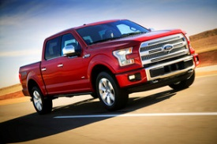
It’s Complicated
Example: the new Ford F150 pickup has 150 million lines of code
Each vehicle has multiple Electronic Control Units (ECUs) from different vendors
Presents multiple attack points for hackers
Complexity is the enemy of security
http://www.informationisbeautiful.net/visualizations/million-lines-of-code/

Slide 12
Examples of Risks
Unauthorised access to vehicles | Keyless door entry systems use mobile apps or electronic key-fobs
Theft of personal information | Owner details, GPS logs, Credit Card info, etc.
‘Hijacking’ of individual vehicles | Feasibility demonstrated by ‘Jeep hack’ (2015)
Creation of mobile ‘bots’ | Vehicle software compromised by hackers and used to launch cyber-attacks
Installation of ‘ransomware’ | Victims must pay money to regain control of their vehicles

Slide 13
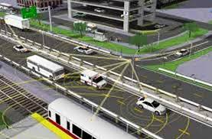
Threats to Infrastructure
Cyber-attacks on infrastructure could cause:
Traffic gridlock
Economic losses
Accidents and loss of life
Massive insurance claims
Political repercussions
Need to think in broad terms
  Private vehicles
  Taxis
  Buses
  Trams and light rail
  Pedestrians and cyclists
  Emergency services vehicles

Slide 14
Vehicle Cybersecurity: emerging solutions

Slide 15
SAE J3061
“Cybersecurity Guidebook for Cyber-Physical Vehicle Systems” – published January 2016
Provides a framework to help organizations
  Identify and assess cybersecurity threats related to vehicles
  Design cybersecurity into cyber-physical vehicle systems throughout the entire development lifecycle process.
  Provides the foundation for further standards development.

Slide 16
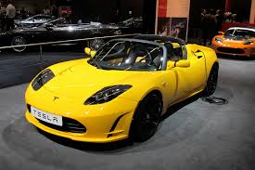
OTA Updates
“Over-the-air” software updates are crucial part of strategy
Already implemented by vendors such as Tesla Motors
Needs to be carefully implemented else OTA service can be hacked

Slide 17
Sharing of Expertise
Automotive Information Sharing
Advisory Centre (Auto-ISAC )
  Established by the Auto industry to facilitate development of cybersecurity expertise within Automotive supply chain
  “An industry-operated environment created to enhance cyber security awareness and coordination across the global automotive industry”
  Published set of ‘Best Practices’ for automotive cybersecurity in July 2016
    https://www.automotiveisac.com/best-practices/

Slide 18
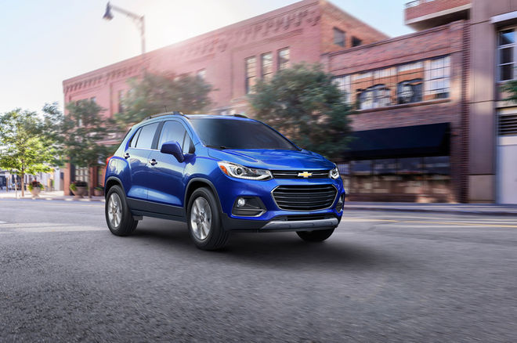
Improve Software Quality
Difficult to accurately estimate extent to which software code may deemed ‘buggy’
Perhaps 1 bug in every 1000 lines of code ??
Major initiatives designed to improve software quality
  NIST 8151 ‘Dramatically Reducing Software Vulnerabilities’
September 2016
General Motors announced recall
of 3.6 million vehicles after fear that
air-bags may fail to deploy due to software fault.
NIST 8151 http://nvlpubs.nist.gov/nistpubs/ir/2016/NIST.IR.8151.pdf

Slide 19
Open Source Activities
Open source
hardware
Open source
code
Bug Bounty
programmes



http://opengarages.org/
index.php/Tools
http://commai.blogspot
.co.uk
https://bugcrowd.com
Significant increase in the level of open source activity in the Automotive space
Vendors such as Fiat-Chrysler now offer ‘bug bounties’ to developers

Slide 20
Vehicle Cybersecurity: some final thoughts

Slide 21


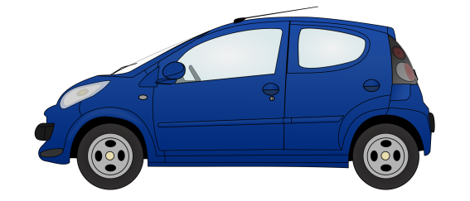
Need for Holistic View
KEY
V2V Vehicle-to-Vehicle
V2I Vehicle-to-Infrastructure
V2P Vehicle-to-Person
Myriad of
Stakeholders
Phone-to-Car
V2V
V2I
Data Storage
Myriad
of attack points
V2P
Data Analytics
Back Office
Billing
Provisioning
Operations
The Cloud
End-to-end Security

Slide 22
Two Distinct Cultures
AUTOMOTIVE INDUSTRY
INFORMATION INDUSTRY
Safety culture
Security culture
Major challenge to create a unified culture
for these two very different industries.

Slide 23
Conclusions
Industry has started to address issues of cybersecurity of vehicles
  Cybersecurity issues for Connected Cars remain poorly understood
  May take 1-3 years for security countermeasures to find their way into products
Fragmented business ecosystem and global supply chains make compliance difficult
Legal and regulatory framework lags well behind rate of technology development
Risk that high costs may result in cybersecurity being given a lower priority than is required
Need to think about cybersecurity from the standpoint of Vehicle Lifecycle ( Initial sale – Resale – End of Life )

Slide 24
Any Questions?

